Slide 1
Alaska Fire Season
January 1 – September 15, 2017

Slide 2
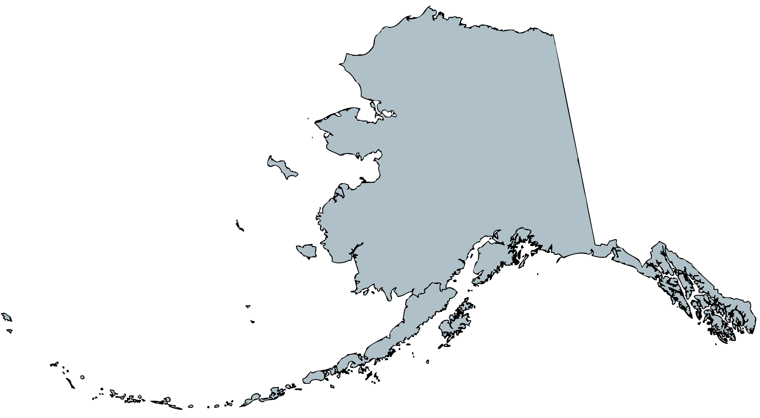
353 Fires 652K Acres

Slide 3
CAUSE

Slide 4
PROTECTION
Alaska Fire Service
169 Fires
571K Acres
Upper Yukon Zone had most acres burn since 2009 (815K)
State of Alaska
170 Fires
81K Acres
154 Prevention Actions
U.S. Forest Service
14 Fires
2.5 Acres
Included Haines Area

Slide 5
LANDOWNER

Slide 6
RESOURCES

Slide 7
A
aircraft

Slide 8
C
crews

Slide 10
E
equipment

Slide 11
O
overhead

Slide 12
S
supplies

Slide 13
NEW INTEL PRODUCT
Alaska Wildfires: Past and Present

